Slide 1
Perpay Loan Application Funnel
David Ko

Slide 2
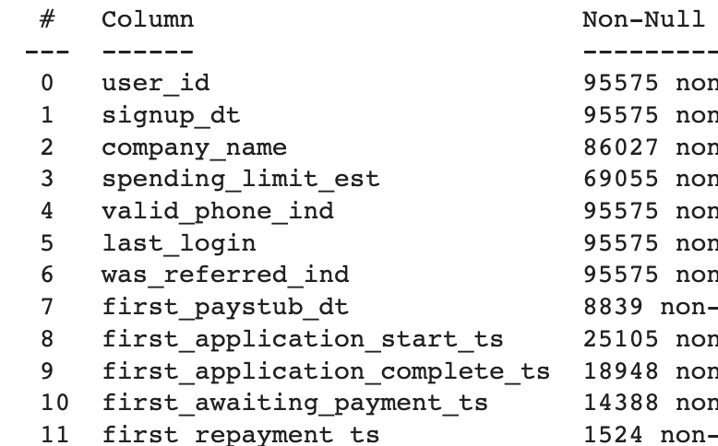
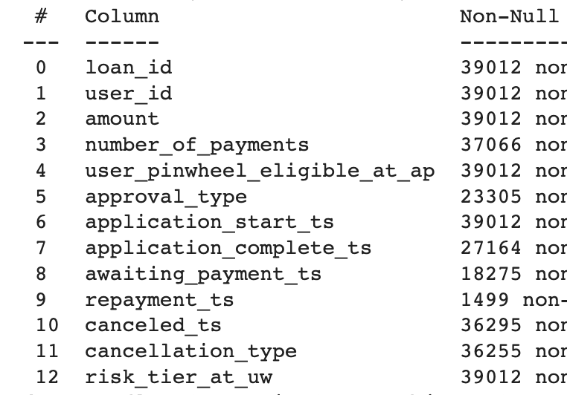
Dataset Null/Non-Null Values
95,575 documented Perpay users from 2020 – 2023
39,012 total loans
Data analysis conducted in slide deque takes into account that multiple loans from the same user are documented in the loan dataset
User dataset
Loan dataset

Slide 3
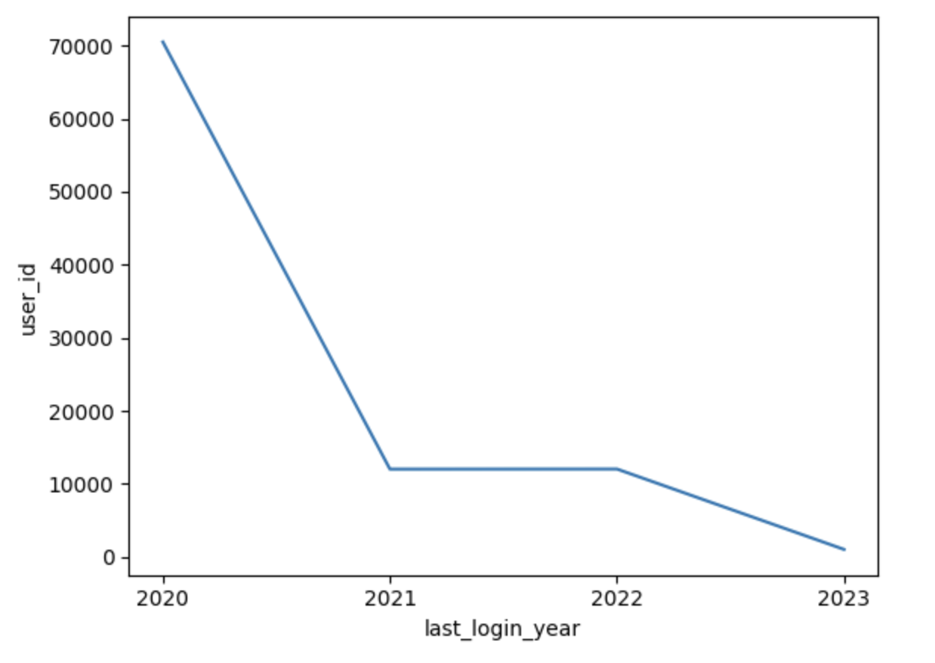
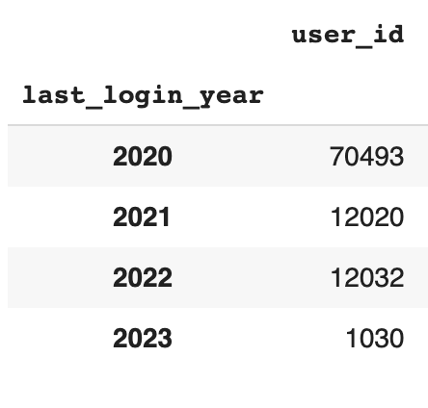
Data Profile: Active Users
Table represents the amount of users who last logged into the Perpay app from 2020 to 2023
Sharp decrease in active users from 2020 to 2021; may be influenced by quality of data, as it’s unlikely that number of users drastically dropped in 1 year

Slide 4
Analysis of Loan Application Process
Average time taken to complete an application: ~22 minutes
Few outliers in data in which users would take a day or so to complete application
Median value provides more insight; the median time it takes to complete an application is less than 1 minute
Not high priority to reduce time in loan application process
Loan Abandonment Rate: 30% of loan applications are not finished once started
Why?

Slide 5

Suggestions to Improve Loan Abandonment Rate
Improve loan abandonment rate → improve efficiency of loan application funnel
Implement chat bots or AI-driven support to user questions are answered immediately
Possible feature to be added → Data Science and/or Software Engineering team
Allow loan application to be user-friendly on mobile device
Ensure that your loan application on mobile device has no glitches and tested on all different types of iOS devices
Simplify loan application process
Make the application process as straightforward as possible; minimize the number of steps and questions

Slide 6
Analysis of Application Approval/Denial Conversion Rate
~95% loan application approval rate
Relatively high loan application approval rate; not high priority to improve approval rate
Quality of data: The remaining ~40% of loans did not specify whether application was approved or denied
Were these loans not finished?

Slide 7
Loans Entering Repayment in 15 Days
With the given dataset, all null values were filtered out, significantly decreasing loan data from 39,012 loans to only 1,499 loans
Among the remaining data with 1,499 loans, ~69% (1039/1499) of loans enter repayment within 15 days of approval
Quality of data: Most of the loan data had no value for the repayment column, which has significant impact on the proportion of loans entering repayment.
Requires further analysis as to why these values are missing

Slide 8
Improving Loan Repayment
Assuming the ~69% loan repayment rate within 15 days is accurate, improvements can be made to increase loan repayment rate
Why improve loan repayment?
Timely loan repayment reduces the chance of a loan default
Improved repayment rates help lenders reduce risk of bad debt
Encouraging Automated Payment
Encourage borrowers to set up automated payments linked to their bank accounts to ensure timely and consistent repayments.
Offer incentives for borrowers who opt for automated payments
Reminders
Send regular repayment reminders through email, text message, or automated phone calls
Maintain open lines of communication with users (Ai bot feature) and offer assistance wherever necessary

Slide 9
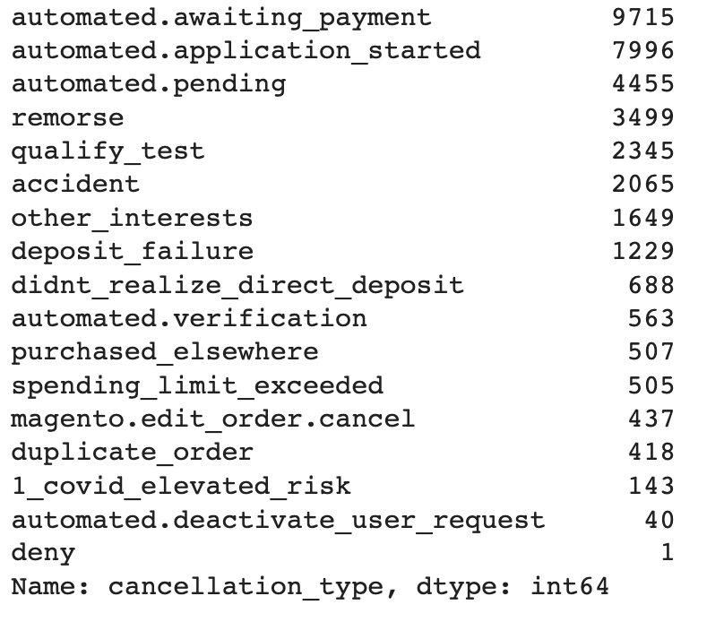
Loan Cancellation Reasons
Top 3 reasons why users cancel:
Automated awaiting payments
Automated application started
Automated pending
High priority to look into what this automated process looks like, and why these 3 reasons lead to over ⅔ of the loan cancellations

Slide 10
High Loan Cancellation Rate
~92% of loans had were canceled
36,255 loans out of 39,012 loans canceled
Suspicious data → requires further data analysis

